Slide 1

Platform Architect @ Syngenta
www.linkedin.com/in/yashwantrao-raut

Slide 2





Data Science Pain Points
Model Onboarding time
Code Reusability
Performance & Scaling
Infrastructure Abstraction
Lack of Monitoring &
Traceability

Slide 3
ML systems require a lot more than ML code
Machine resource management
Machine resource management
Data veriﬁcation
Data veriﬁcation
Data collection
Serving infrastructure
Conﬁguration
Data collection
Serving infrastructure
Conﬁguration
Monitoring
Monitoring
ML Code
ML Code
Features extraction
Features extraction
Data analysis
Data analysis
Source: https://proceedings.neurips.cc/paper/2015/ﬁle/86df7dcfd896fcaf2674f757a2463eba-Paper.pdf

Slide 4




Model journey
Retrain Model
Develop & Train Model
Evaluate Model
Package Model
Test
Deploy
Run & Monitor
Code
Training code
Training code
Application code
Code and model in production
Model
Candidate models
Chosen model
Packaged model
Production-ready model
Data
Training data
Test data
Metrics
Test data
Production data

Slide 5






ML Platform pillars
Data
Data Science Development platform
Deployment platform
MLOps Team
Model building
ML engineers, developers
Training code
Deployment
Model
Labelled data
production
Web app code
Data engineers
Data scientists
Notes:
- This slide talks about 3 core Pillars of any ML platform also Highlights Key capabilities of the Insights Engine platform listed on the extreme Right section
Data Engineers take care of cleaning, labelling, and filtering the data
This clean data is used by data scientists to build their models
Which are then passed to the MLE Engineers and Developers to optimize it, create API wrapper around it and be deployed to PROD environment
This whole process of optimizing the model, building API wrappers, and deploying to PROD is taken care of by IE team

Slide 6
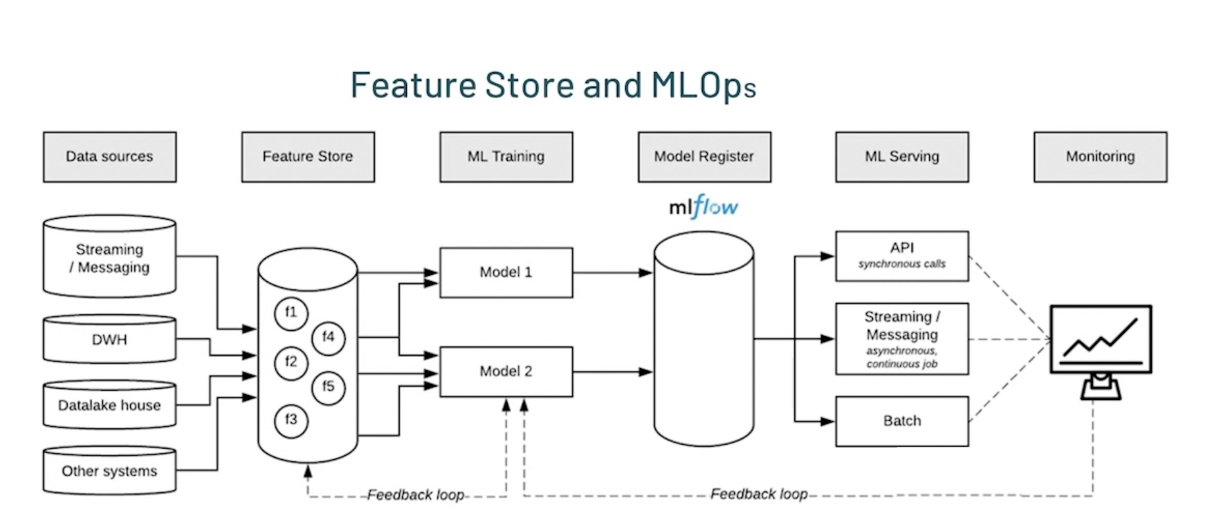
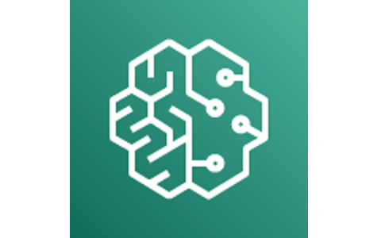

Slide 7
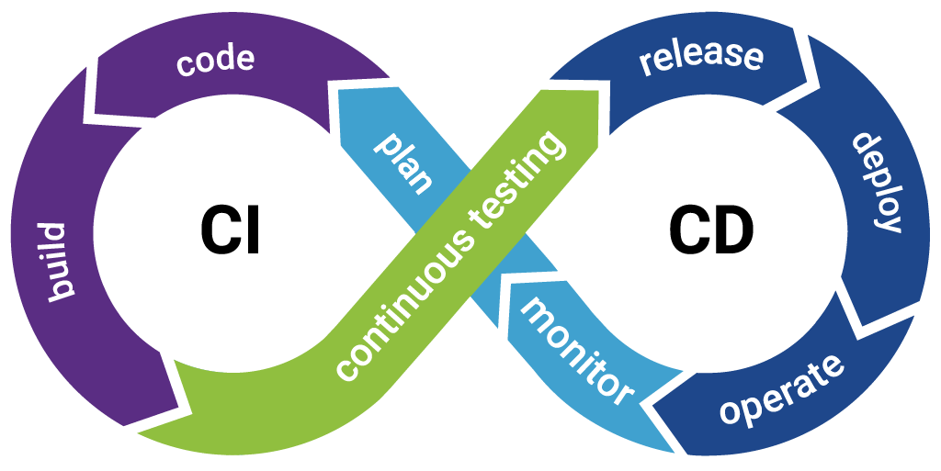

Slide 8
CICD
Continuous Integration and Continuous Deployment (CI/CD)
Jenkins
GitLab CI
CircleCI
Travis CI
GitHub Actions
Source code management (SCM)
Build
Test
Deploy
Release

Slide 9
Continuous Integration (CI)
GitHub/GitLab
1
Code Commit
Developers commit changes to the codebase, triggering the CI process.
Build Tools,
2
Build & Test
Maven, Gradle, Webpack
Automated build and test procedures are executed to ensure code quality and model integrity.
Central Repo
Artifact Storage
3
ECR, Gemfury, Maven Central, PYpi
Successful builds and trained models are securely stored as versioned artifacts.

Slide 10



Continuous Deployment (CD)
Deploy
Promote
Monitor
On Dev
Promote to next Env, Till production
Monitor the deployment
Capacity Provision
Verify Side Effects
Side Effects
Dependency Planning
Acceptance Testing
Resource Consumption
Verify Integrations
Usage
Verify Integrations
Performance Testing
Cost
Logs
Health

Slide 11
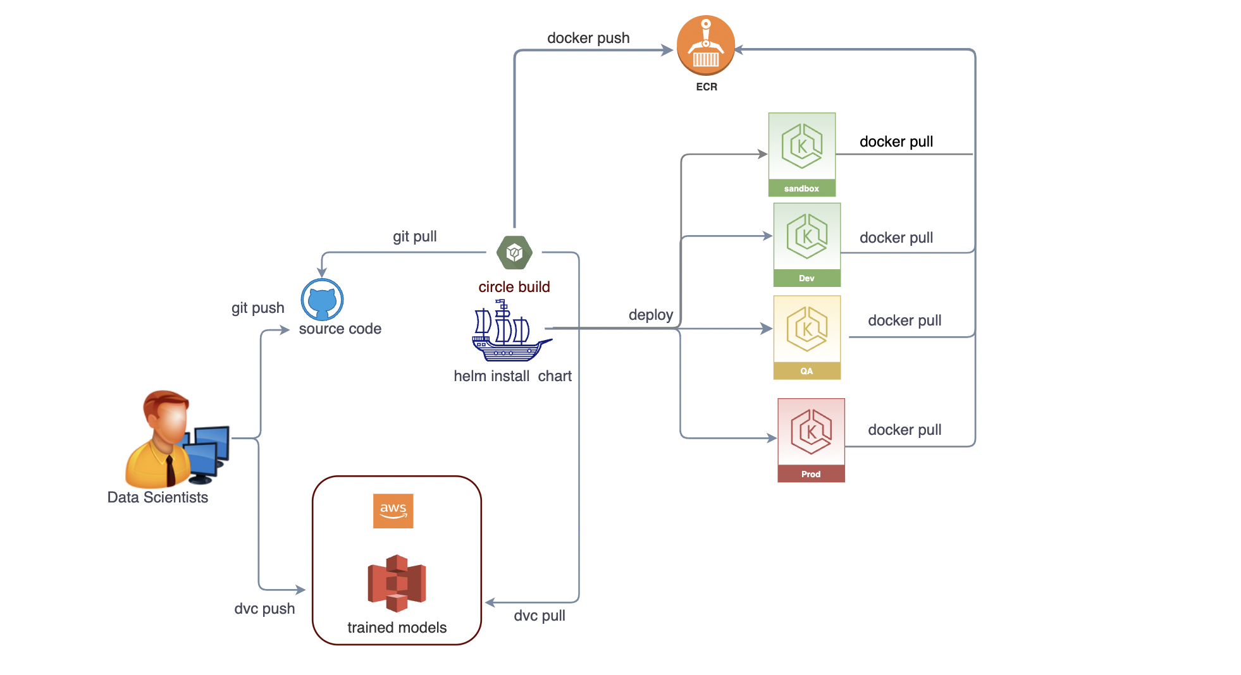
CI/CD Process

Slide 12
Integrating CI/CD with MLOps
Data Versioning
Model Monitoring
Workflow Automation
CI/CD integrates with data versioning systems to ensure reproducibility and traceability of training data.
Automated model monitoring in the CI/CD pipeline helps detect drift and triggers retraining or redeployment.
CI/CD streamlines the entire ML/AI lifecycle, from training to deployment, reducing manual intervention.

Slide 13
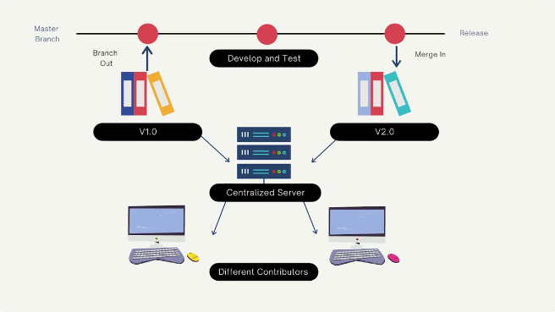
Versioning and Reproducibility in CI/CD for ML/AI
Code Versioning
Maintain version control of model training code, scripts, and dependencies.
Data Versioning
Version training and validation datasets to ensure reproducibility.
Model Versioning
Store trained models, hyperparameters, and evaluation metrics as versioned artifacts.
Environment Versioning
Capture the full software environment, including libraries and frameworks.

Slide 14

DEMO

Slide 15
Thank you
www.linkedin.com/in/yashwantrao-raut

